Slide 1
Vision & Speech Interface
For Robotic Arm
By AI-RedBack
19 Oct 2023

Slide 2
Team & Stakeholders
Scrum Master Sicheng Nie
Product Owner Renwei Hu
Architecture Lead George Wang
Deployment Lead Siyi Liu
Client Dr. Wafa Johal
Supervisor Sebastian Bobadilla

Slide 3
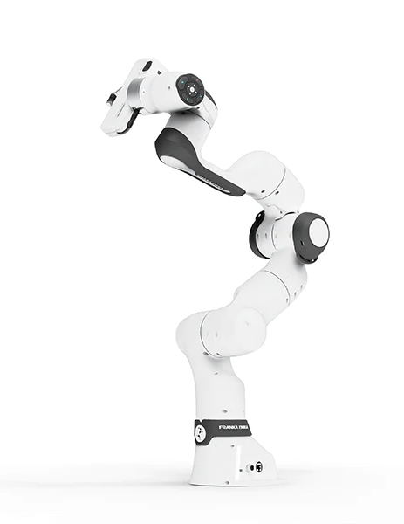
Project Introduction
Robot Operating System (ROS)
Computer Vision System
Voice Command Interface
Franka Emika

Slide 4
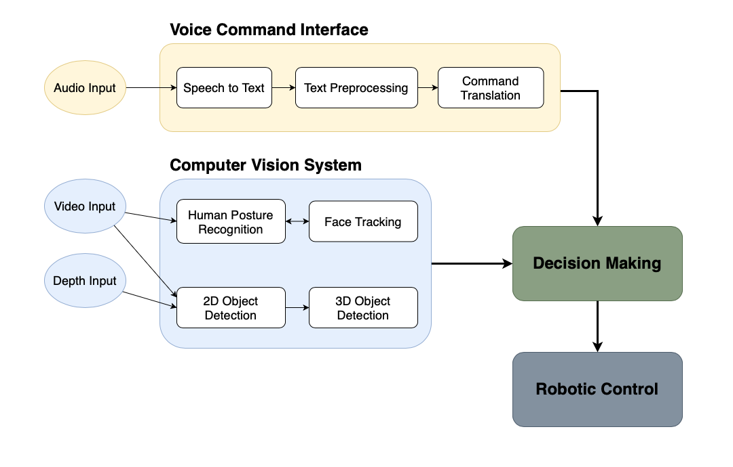
System Architecture
Perception
Decision
Action

Slide 5
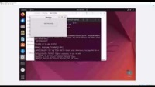
Demo - Voice Command Recognition
Voice Recording
Voice to Text
Text Analysis

Slide 6
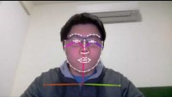
Demo - Human Posture (Face)
Using Openpose
70 Facial keypoints
Tracking eyebrows, eyes, mouth
Reduced accuracy for better speed
Notes:
For the tracking of facial expressions and hand gestures, Openpose was used. Here is a short demo of the facial tracking capabilities. Play Face Demo (10:00). As you can see, Openpose is able to track the eyebrows, eyes, mouth, and the curve of the face. In order to increase the speed, the accuracy of the model was reduced.

Slide 7
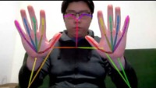
Demo - Human Posture (Hands)
Using Openpose
21 keypoints per hand
Tracking joints of each hand
Reduced accuracy for better speed
Notes:
Here is the tracking for hand gestures. Play Hand Demo (7:00). As can be seen, Openpose tracks the joints of the hands. As seen, the connections between keypoints are such that a hand is generated. Similar to the face demo, the accuracy of the model was reduced. I will now hand it over to Jackson for object detection.

Slide 8
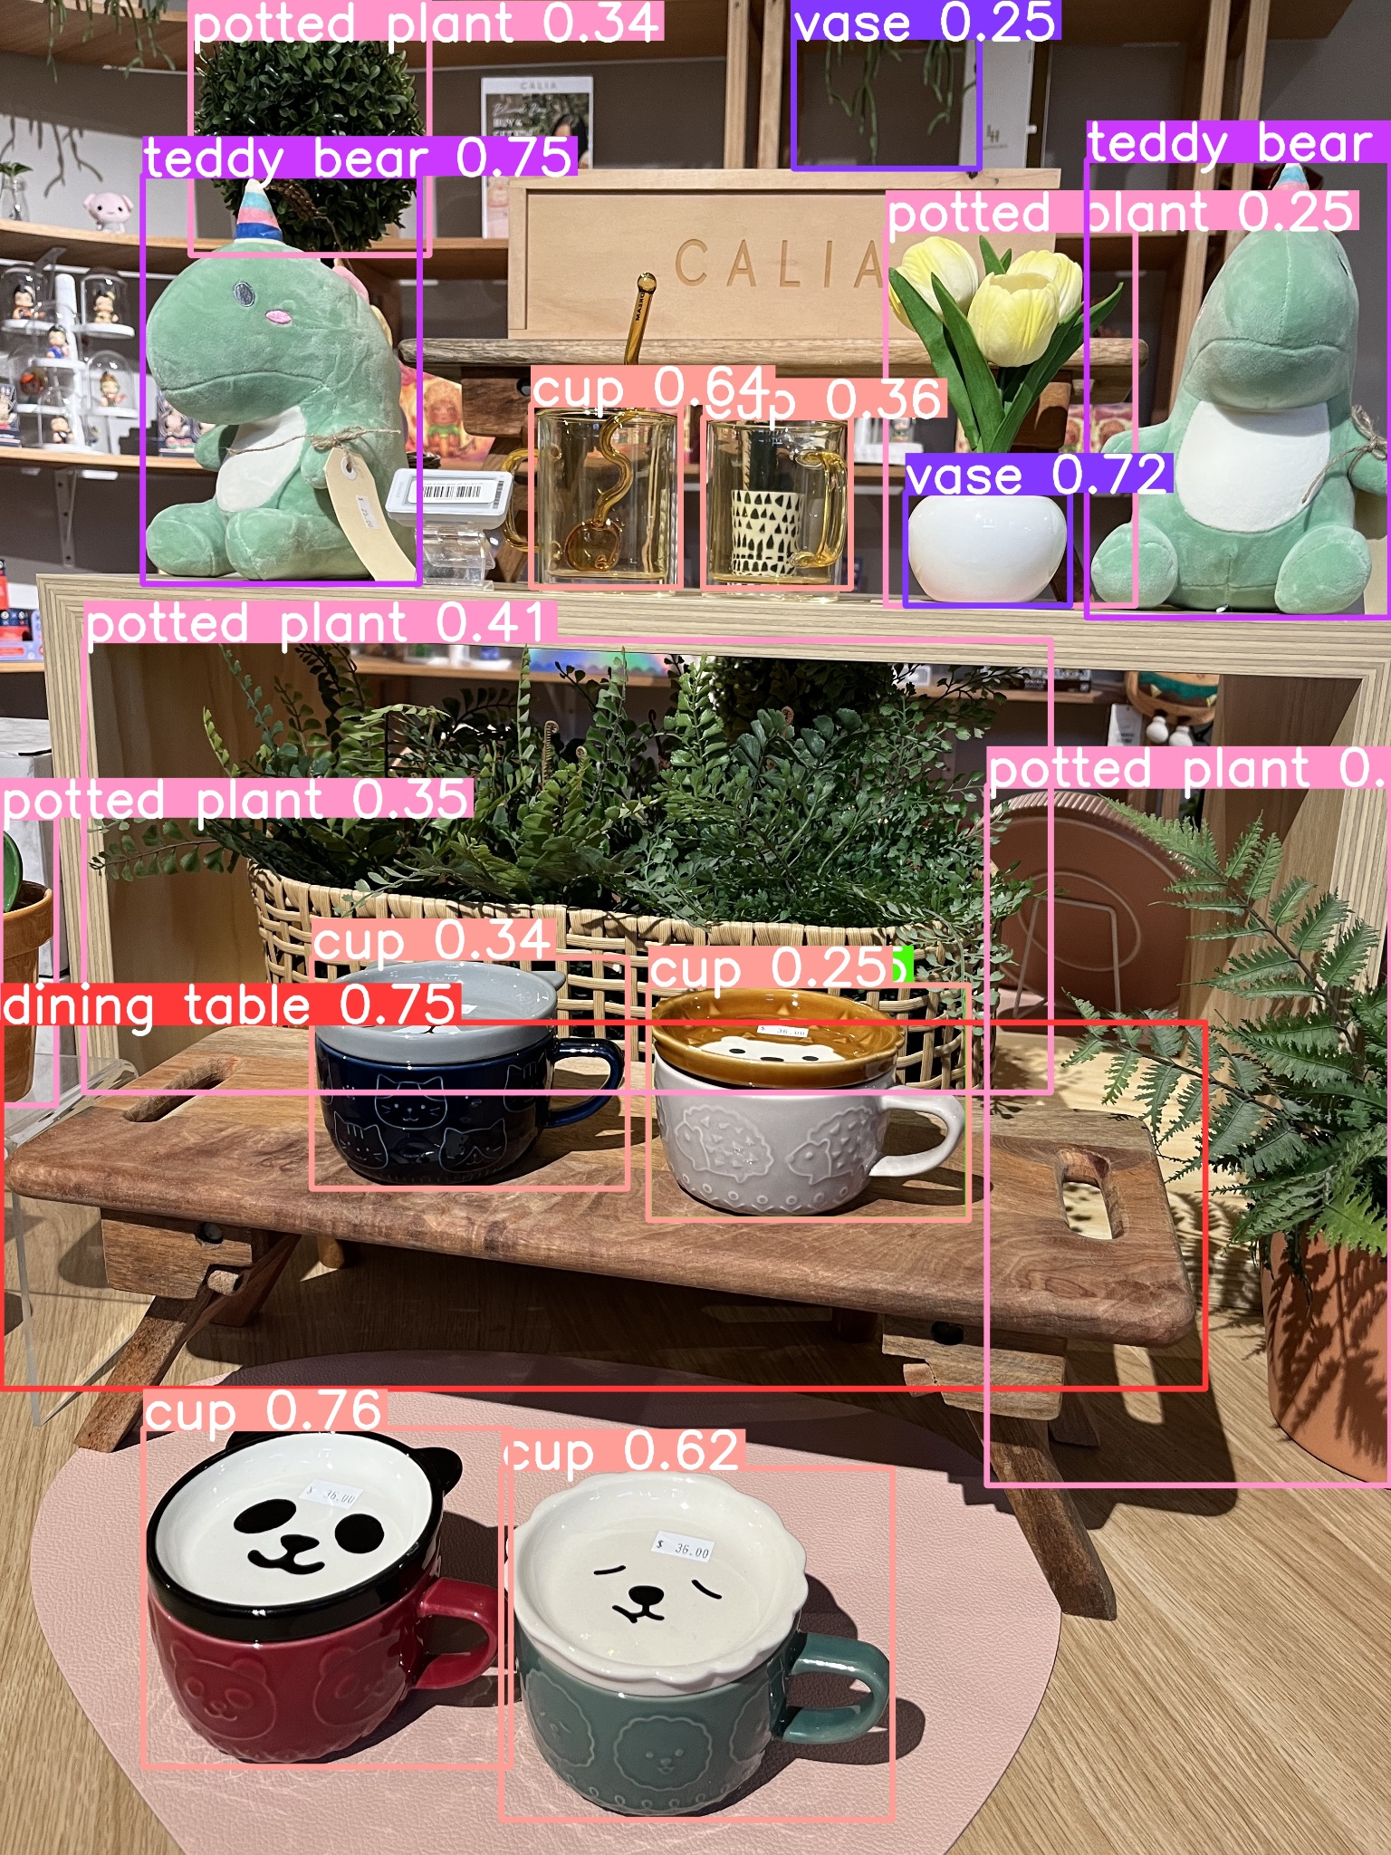
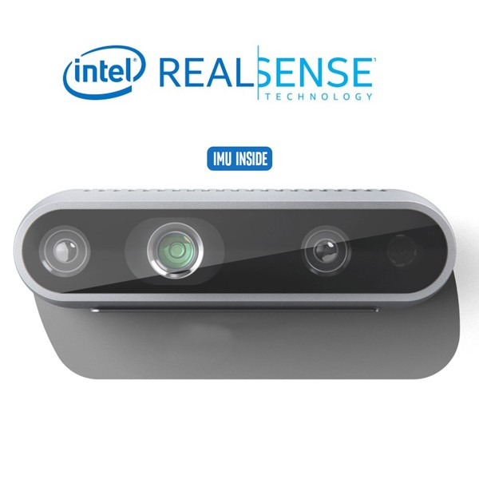
Demo - Object Detection
Intel RealSense Depth Camera
YOLO Model

Slide 9
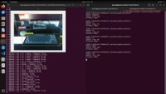
Demo - Object Detection

Slide 10
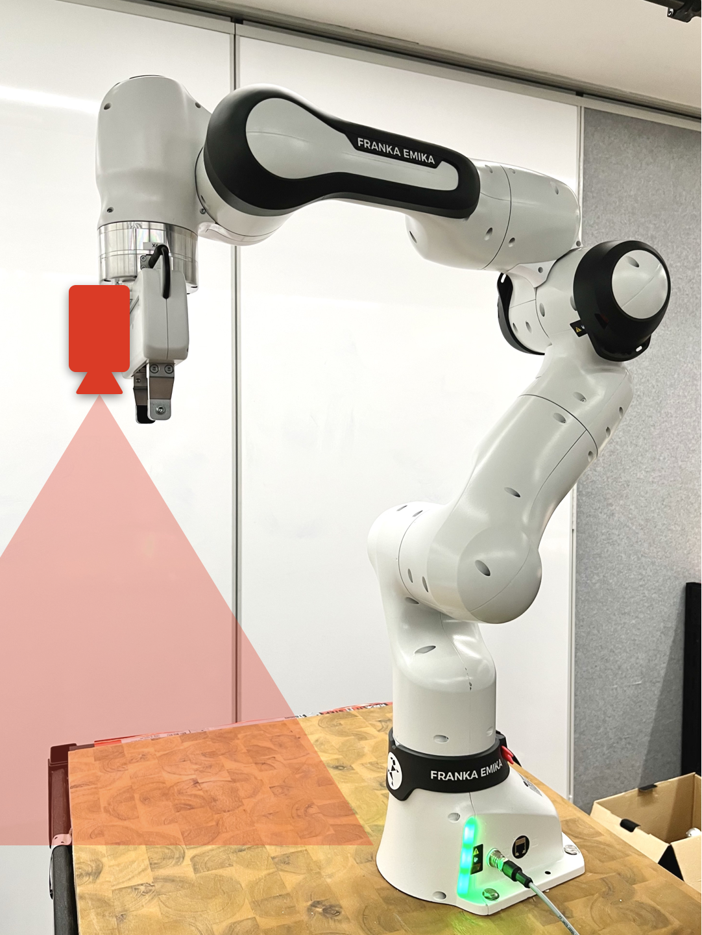
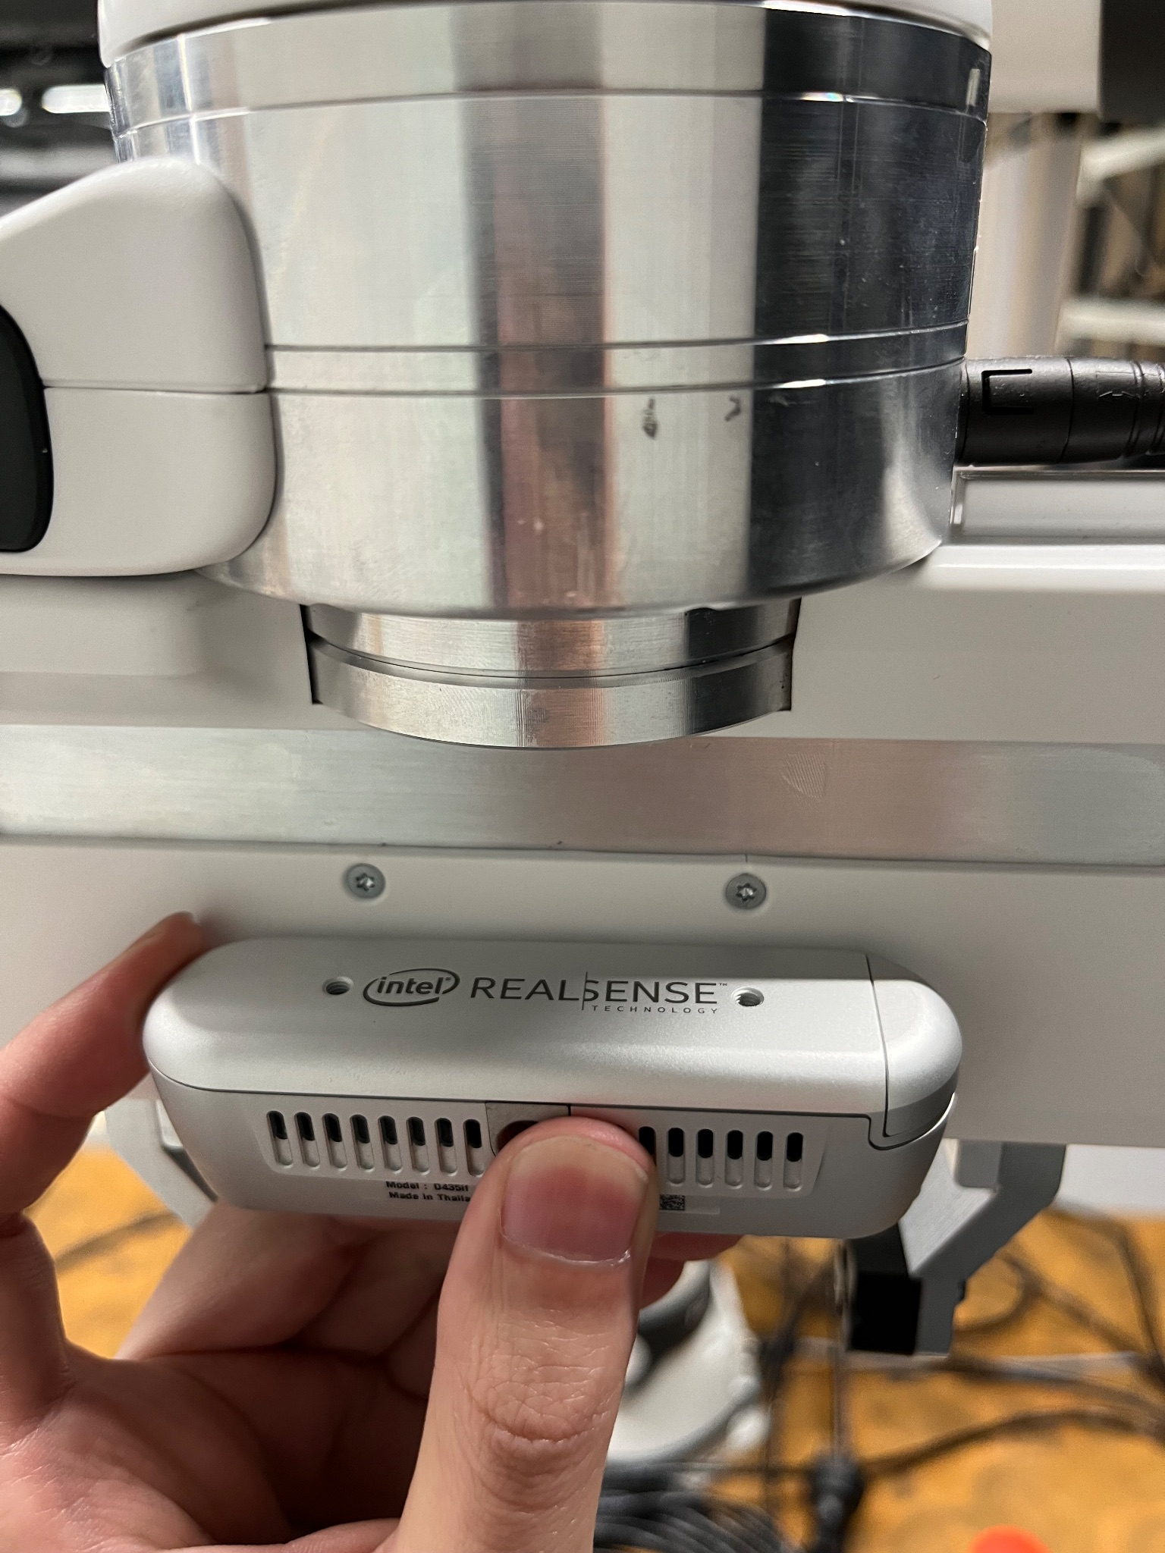
3D Printed Mounting Model

Slide 11
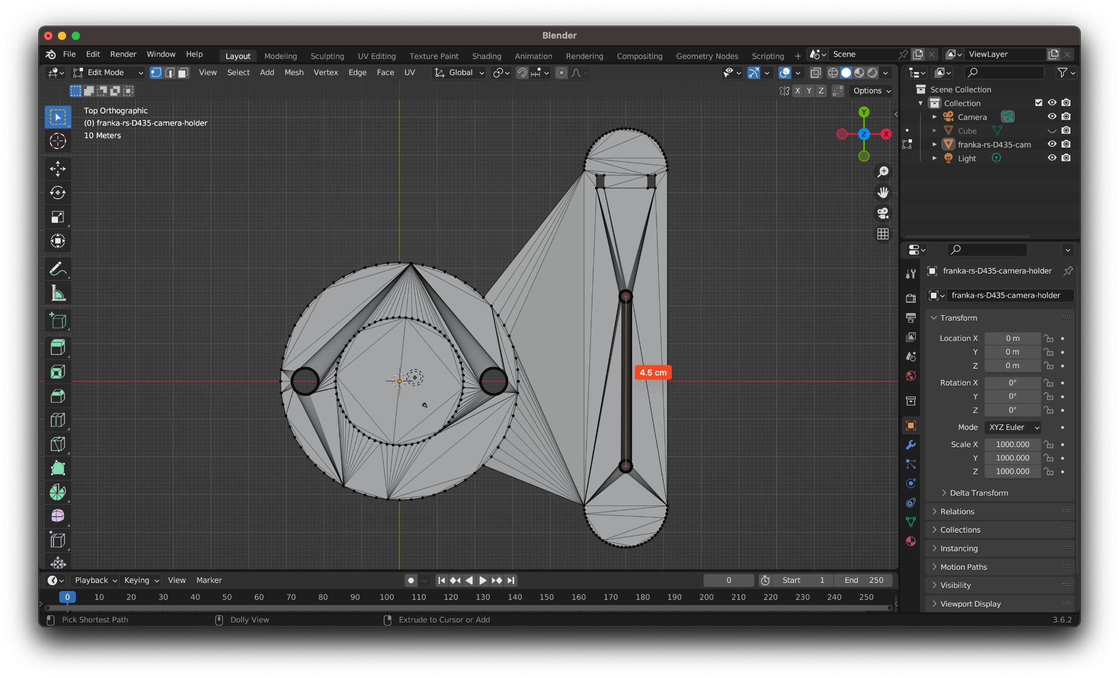
3D Printed Mounting Model

Slide 12
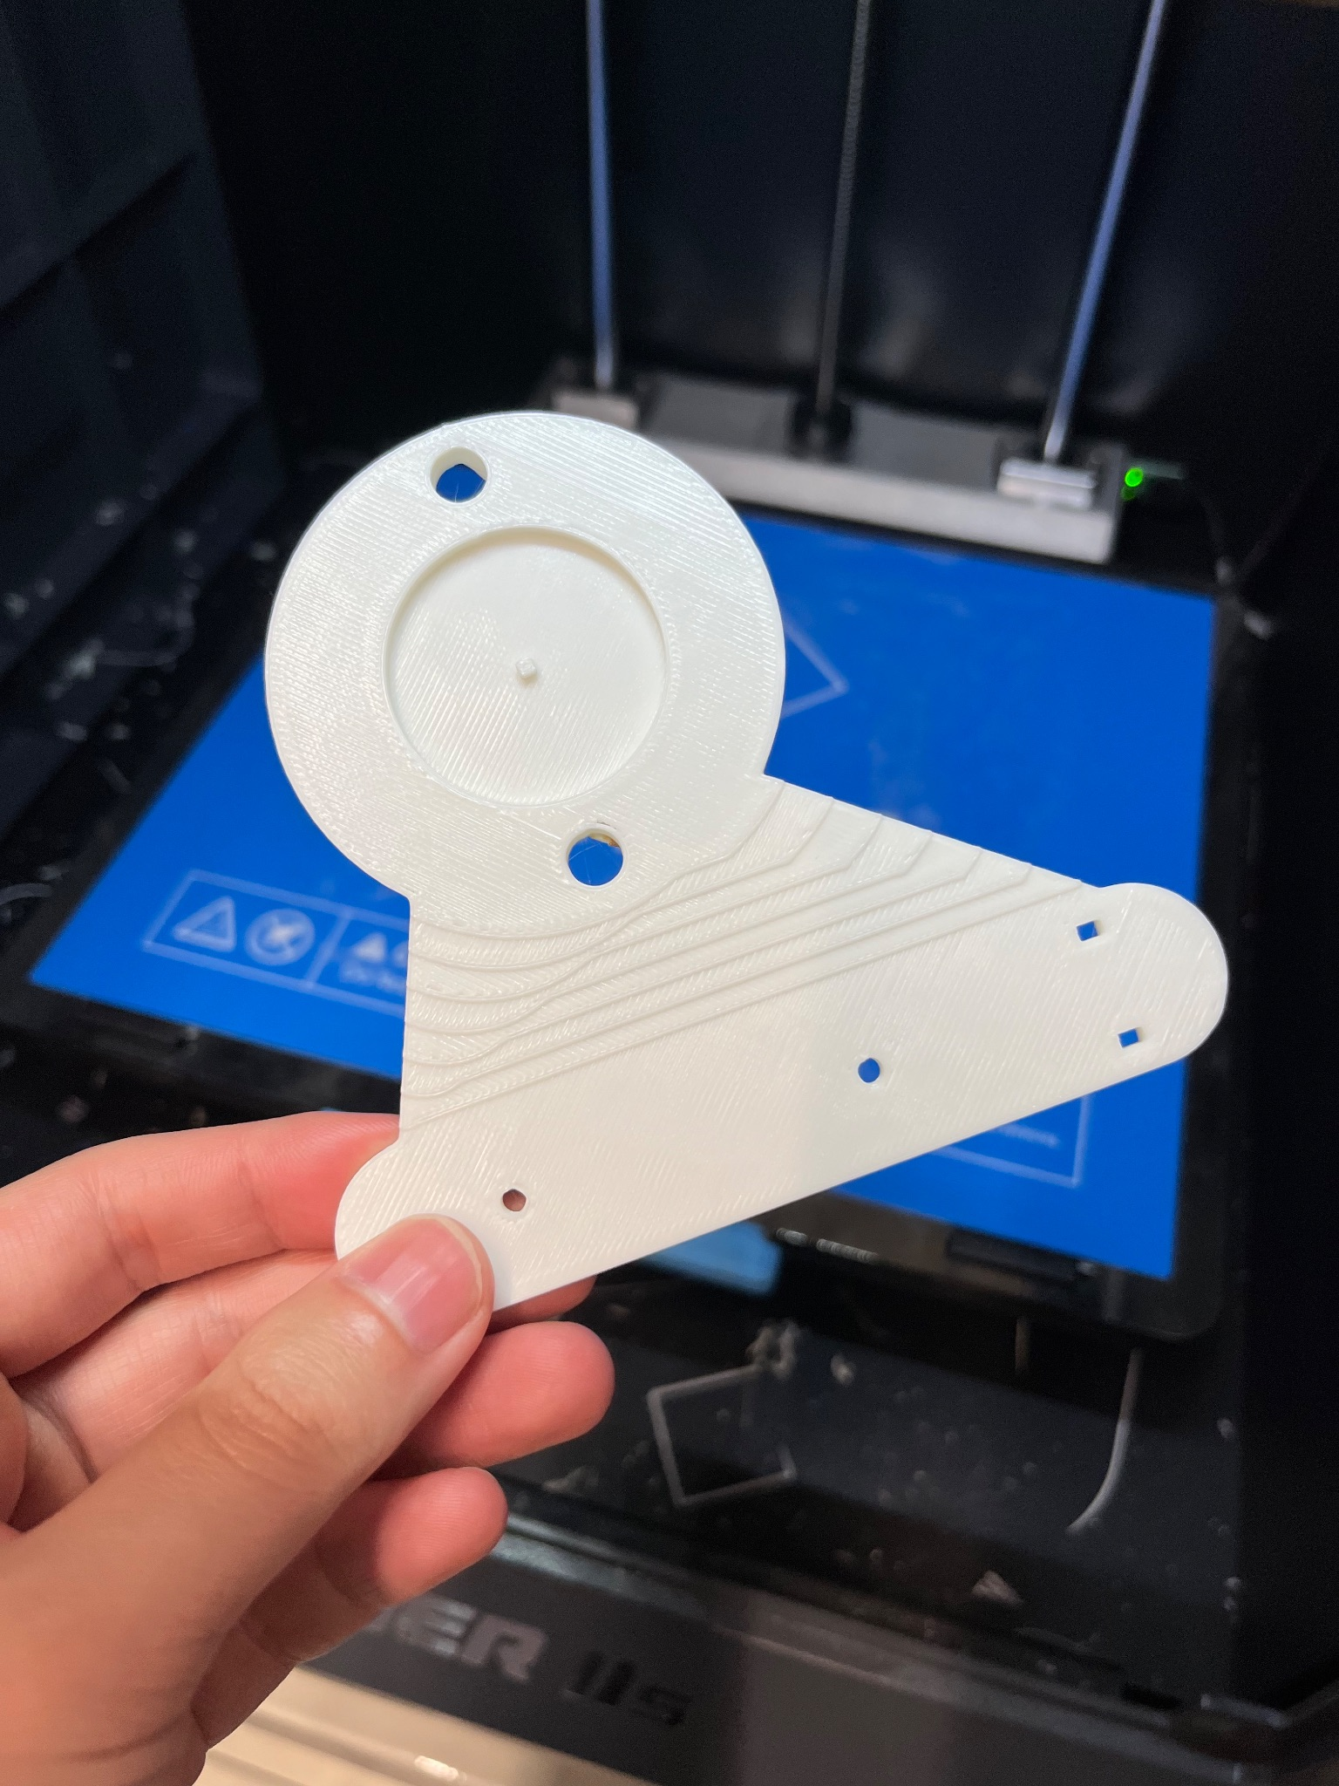
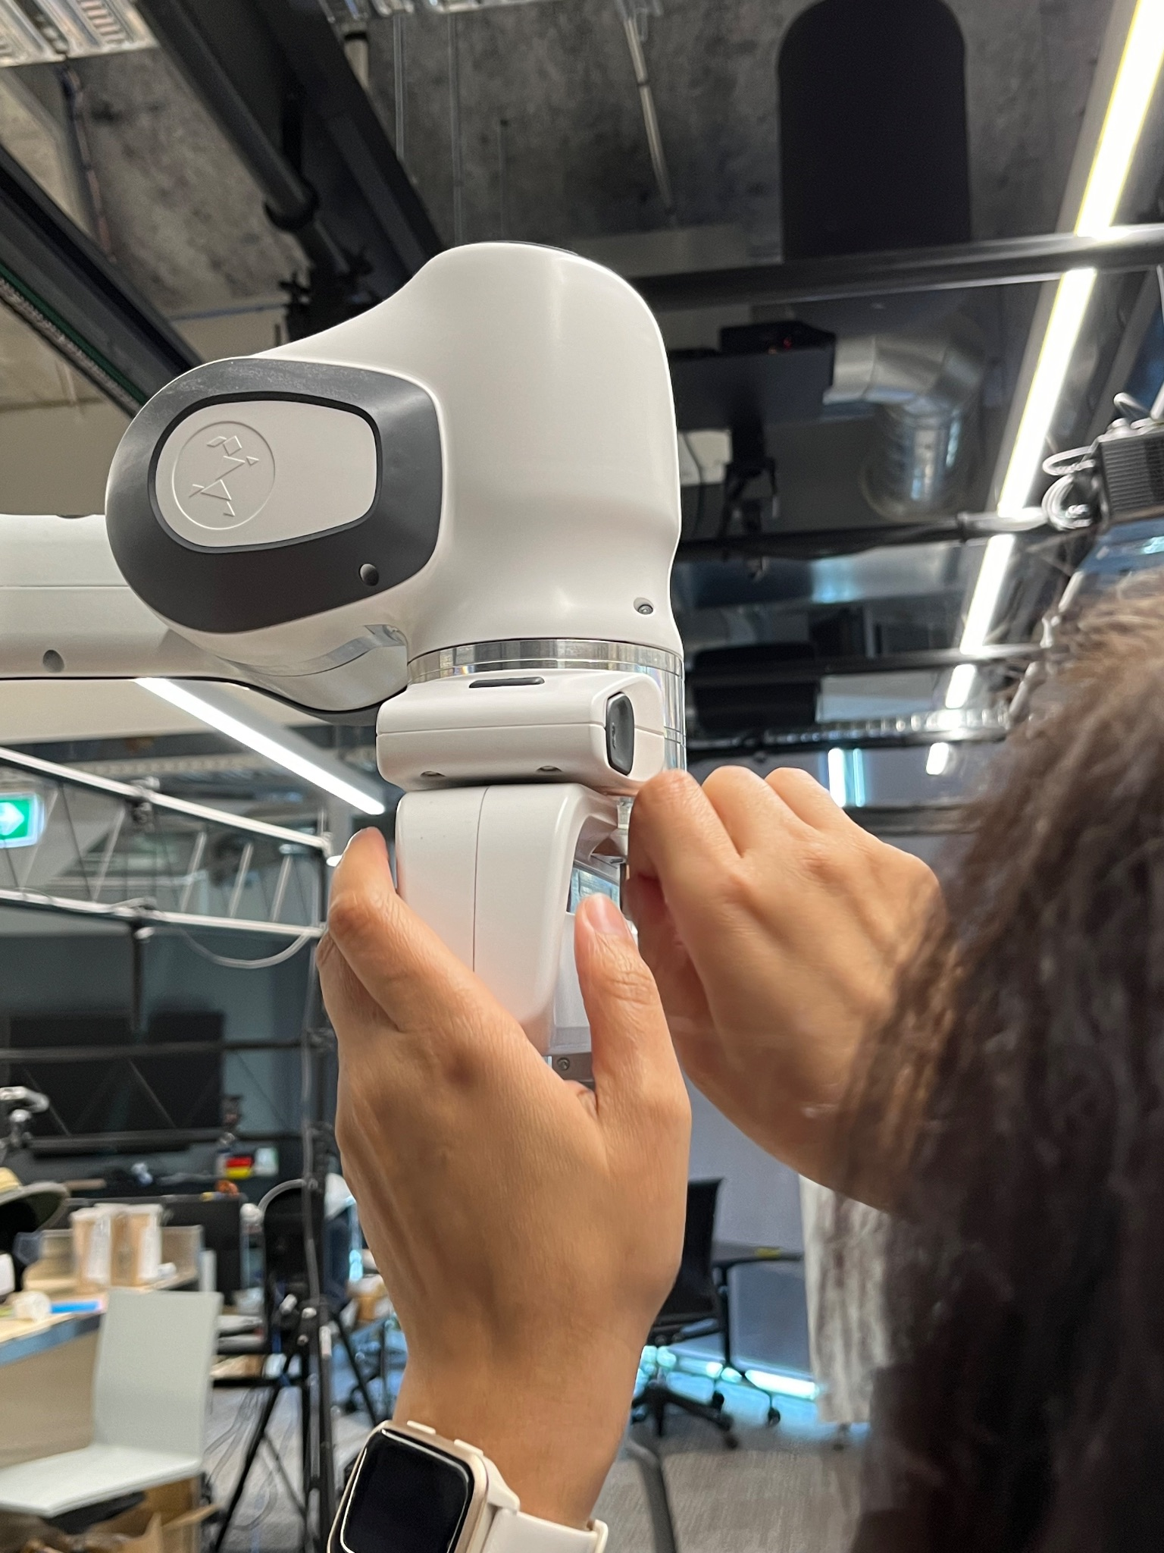
3D Printed Mounting Model

Slide 13
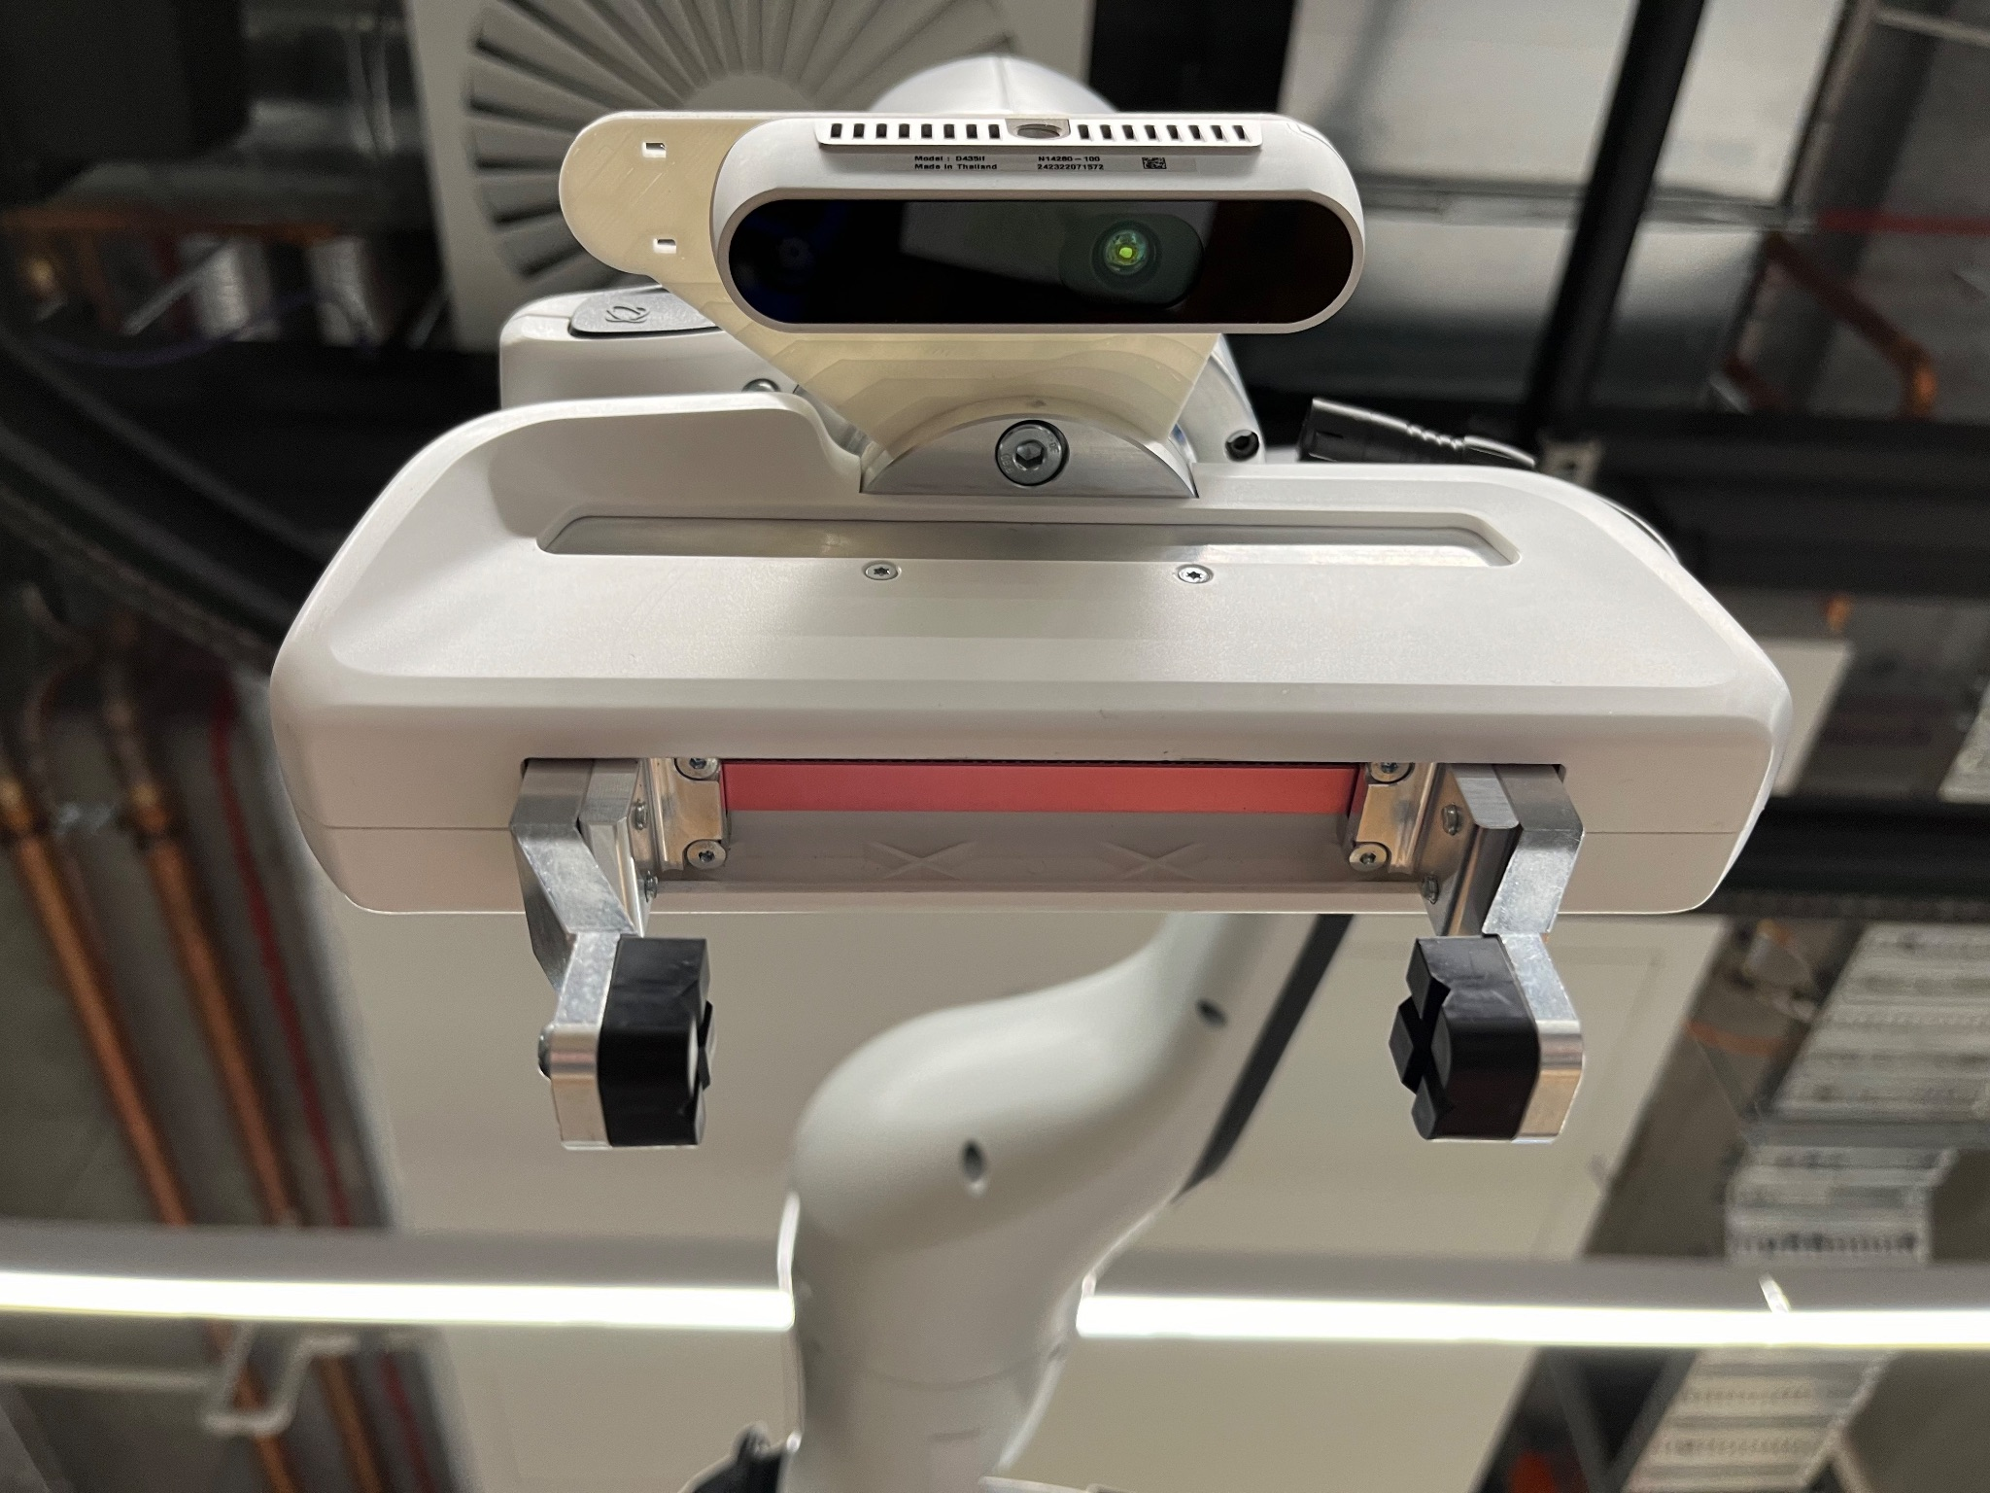
3D Printed Mounting Model

Slide 14
Project Review
User Story Completion Status
Completed: CV (Computer Vision), VR (Voice Recognition)
Partially Completed: RC (Robotic Control) up to RC.1
Not Started: DM (Decision Making), SS (System Status), Remaining RC
Scope Adjustment
Removed Epics: DM (Decision Making), RC (Robotic Control), SS (System Status)
Primary Focus: CV (Computer Vision), VR (Voice Recognition)

Slide 15

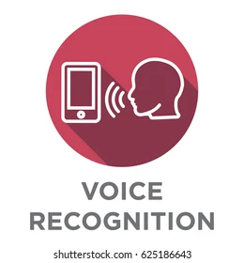
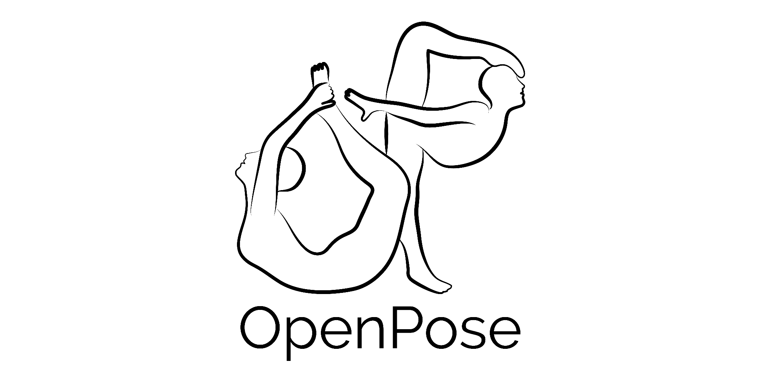


Project Handover
Voice Command Recognition Node
Human Posture Node
Object Detection Node

Slide 16
Lessons Learned
Reflection
Steep learning curve with ROS.
Delays in lab access till Week 7.
Importance of flexibility and client communication.
Lessons Learned
Importance of domain knowledge in robotics.
Adjusting scope based on resources and time constraints.
Value of continuous feedback and adjustments.

